Slide 1
Measuring Antenna Patterns for Ground Station
Joshua Smith
Mentor : Dr. Mike Parker
Rincon Research Corporation
April 17, 2021
Virtual symposium

Slide 2
CatSat
The University of Arizona is launching a 6U CubeSat called CatSat in the Spring of 2021
Includes the High Frequency, Inflatable Antenna, Earth imaging, Ionospheric Experiment etc.
Source: https://uanews.arizona.edu/story/ua-studentled-catsat-mission-selected-nasa
Statement of the problem;
CatSat’s orbit is projected to near 550 km
Notes:
Statement of the problem;
CatSat’s orbit is projected to near 550 km

Slide 3
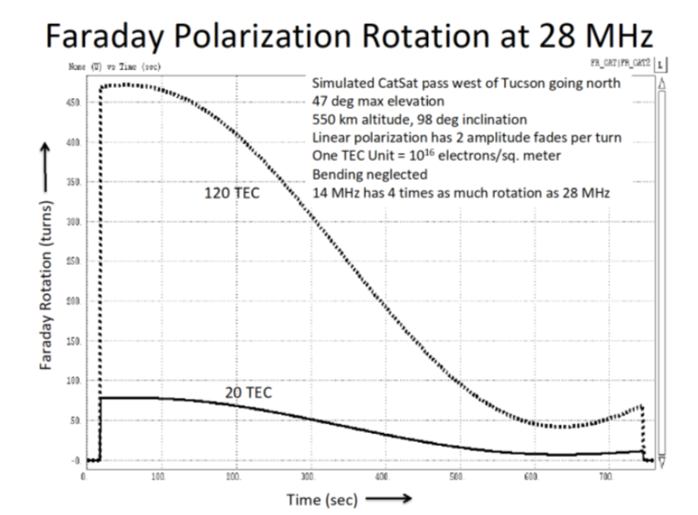
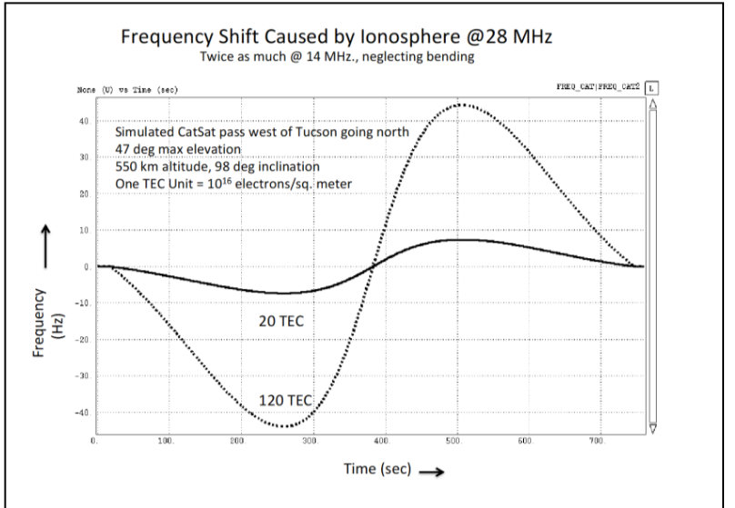
Recap from Last Year
Last Year my research aimed at predicting Ionospheric effects of Polarization and Frequency Shift
This year I was tasked with producing to Antenna Scan Patterns
Plots are from Paper Submitted to the 38th Annual AMSAT Space Symposium held on October 17, 2020 09:00 CDT

Slide 4
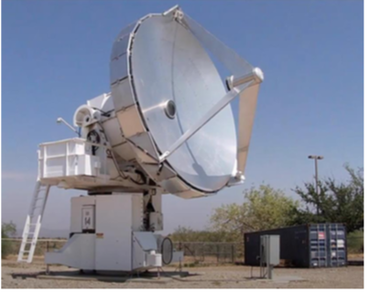
The Problem with Satellite Tracking
Statement of the problem;
Using Two Card element sets we can predict Azimuth and Elevation for Satellite passes
This may not be sufficiently accurate enough or may not be available
What happens if it is unavailable?
Conduct Scan Patterns to measure signal power and satellite's locations
6.1 meter dish at Biosphere
Source: Dr. Mike Parker

Slide 5
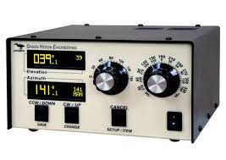
Objectives
Develop software that would control azimuth and elevation scan patterns
Write code to send commands to move Az El Rotators with Green Heron RT-21 controller
Write Positions of Azimuth and Elevation into an excel File
Use Yagi antenna to measure/record Gain as a function of Azimuth and Elevation for Ham station on Mount Lemmon
Control computer
Points receiver antenna and records power vs time
Follows ephemeris predictions
Scans about predicted pointing
Analyzes data and compares with modeled data
Verify using available satellites
Expand Process to 6.1 Meter dishes
https://www.greenheronengineering.com/product/model-rt-21azel-rotator-controller-az-el/

Slide 6
Methods/activities/analysis techniques;
Azimuth Vs Time
degrees
Year: Month: day:: Hour: Min: Sec
Notes:
Using equations obtained from John A Kolobuchar paper Total elctron Content studies,
I wrote C code that allows you to input given coordinates for a ground station, Vertical Total Electron content, a salatites postion Data optained form a SPG module
To produce Group delay/Slant Total electron and number of faraday rotations for passes over that ground station, given the satalites transmitting at 100 MegaHertz

Slide 7
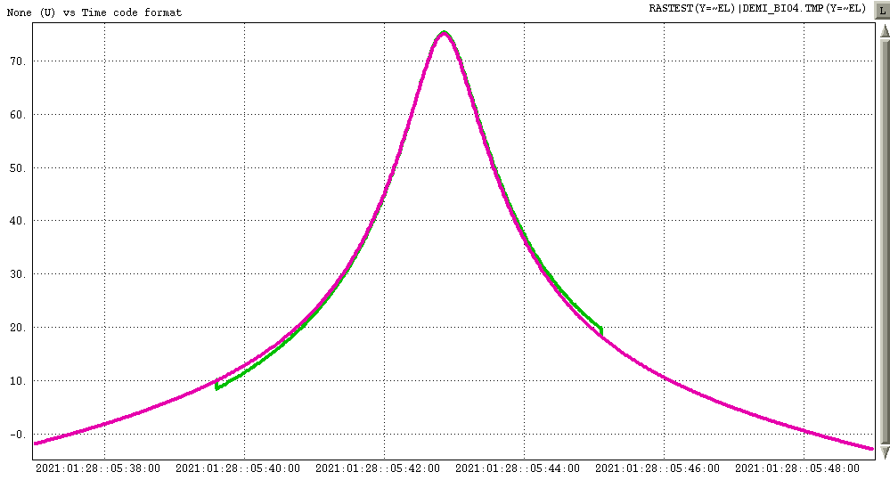
Methods/activities/analysis techniques;
Elevation Vs Time
degrees
Year: Month: day:: Hour: Min: Sec
Notes:
Using equations obtained from John A Kolobuchar paper Total elctron Content studies,
I wrote C code that allows you to input given coordinates for a ground station, Vertical Total Electron content, a salatites postion Data optained form a SPG module
To produce Group delay/Slant Total electron and number of faraday rotations for passes over that ground station, given the satalites transmitting at 100 MegaHertz

Slide 8
Elevation Vs Azimuth
degrees
degrees

Slide 9
Elevation Vs Azimuth
degrees
degrees

Slide 10
Elevation Vs Azimuth
degrees
degrees

Slide 11
Elevation Vs Azimuth
degrees
degrees

Slide 13
Results
Antenna Gain Vs Time for Section of pass
452.4 MHZ
Rotor Position Sweep. EL: 5 deg. AZ: [5, 45] deg
Frequency
452.3 MHZ
Time
Constant EL of 5 deg. AZ: [5, 45]
Red: [-63,-68] dBm
Green: [-80,-79] dBm
Time/dev = 500ms

Slide 14
Results
Antenna Gain Vs Time for Section of pass
Rotor Position Sweep. EL: 15 deg. AZ: [45, 5] deg
452.4 MHZ
Frequency
452.3 MHZ
Constant EL of 15 deg. AZ: [45, 5]
Time
Red: [-63,-68] dBm
Green: [-80,-79] dBm

Slide 15
Results
Antenna Gain Vs Time for Section of pass
452.4 MHZ
Rotor Position Sweep. EL: 45 deg. AZ: [5, 45] deg
Frequency
452.3 MHZ
Constant EL of 45 deg. AZ: [5, 45]
Time
Yellow: [-74.48] dBm
Green: [-80,-79] dBm

Slide 16
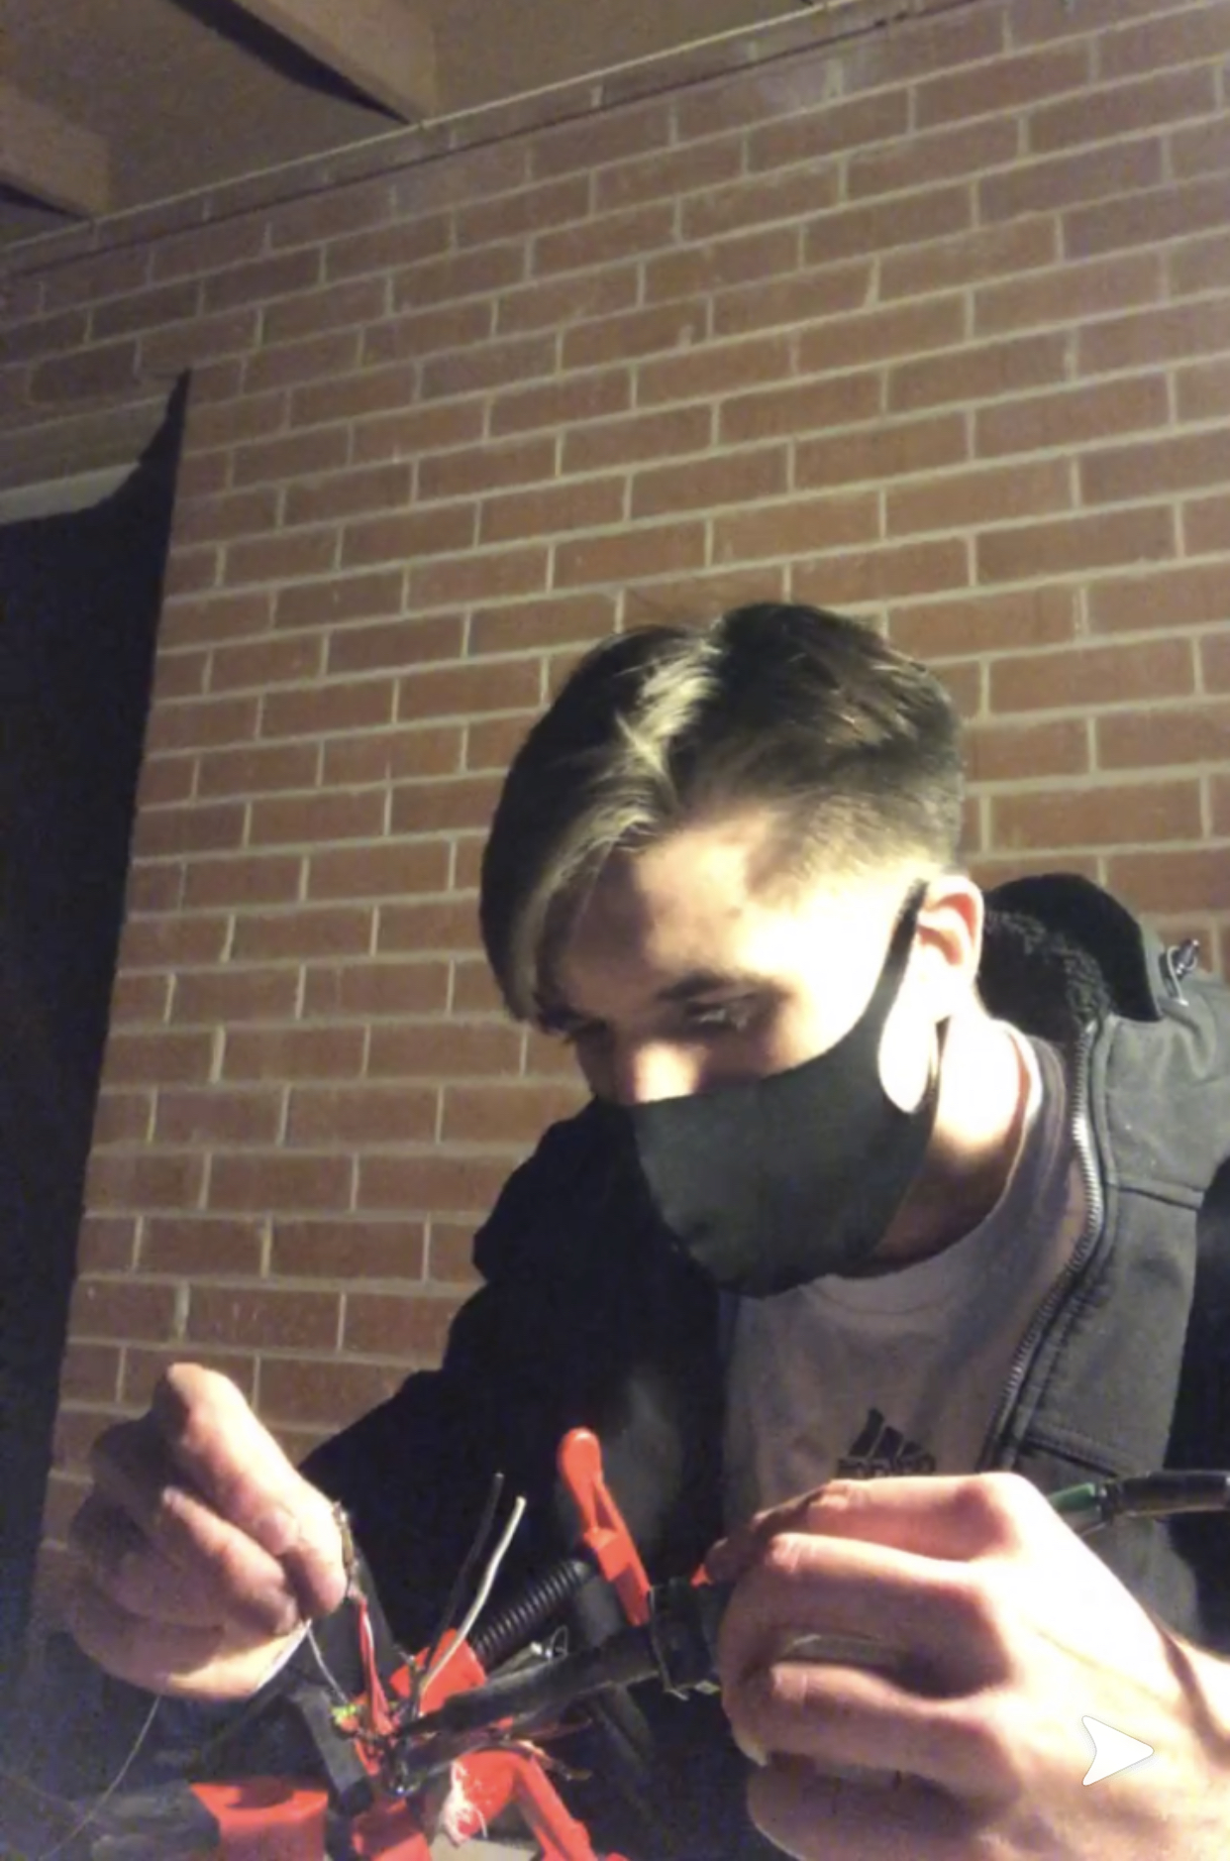
Why is this Important?
This would be useful in measuring the antenna’s beam shape
Would help in detecting errors and predicting better satellite orbits
Notes:
Interpretations of these predictions
Match how STEC should increase at the horizons and reach a minuim when directly above the GD
Matches the behavior of how Faraday rotation should reverse in direction for this high pass
Skeptical about magnitude of FR
Don’t know actual TEC, it can vary greatly but we can measure the # of faraday Rotations
Worst case scenario
Model can tell us if something is wrong

Slide 17
Conclusion/Future work
Conclusion
Enhanced knowledge on how to implement Software to Hardware Interfaces
Data of Azimuth and Elevation read in from RT21 controller can be off by 1 to 2 degrees at endpoints
Future work
Read in data from Real time Spectrum Analyzer to be used with a Controller
Implement scan patterns onto plots of AZ and EL of Satellites
Verify using available satellites
Expand Process to 6.1 Meter dishes

Slide 18
Acknowledgements
Thank you so much to….
Dr. Mike Parker
Rincon Research
Michelle Coe
Chandra Holifield
Arizona Space Grant Consortium
Del Spangler

Slide 19
Thank You!!

